Slide 1
22C:19 Discrete Structures Logic and Proof
Spring 2014
Sukumar Ghosh

Slide 2
Predicate Logic
Propositional logic has limitations. Consider this:
Is x > 3 a proposition? No, it is a predicate. Call it P(x).
P(4) is true, but P(1) is false.
P(x) will create a proposition
when x is given a value.
Predicates are also known as propositional functions.
Predicate logic is more powerful than propositional logic
subject
predicate

Slide 3
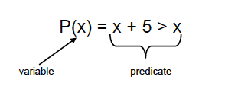
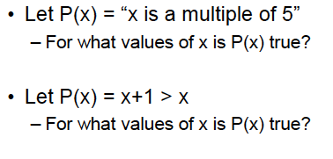
Predicate Logic

Slide 4
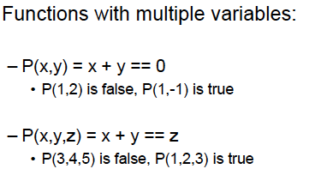
Examples of predicates

Slide 5
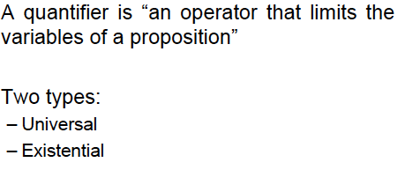
Quantifiers

Slide 6
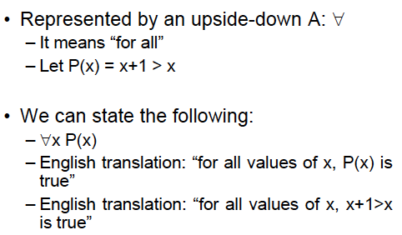
Universal Quantifiers

Slide 7
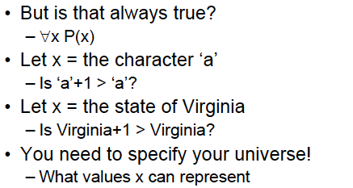
Universal Quantifiers
Perhaps we meant all real numbers.

Slide 8
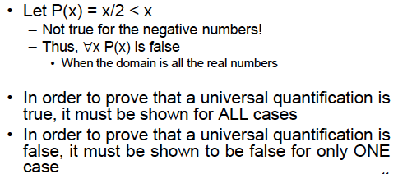
Universal Quantifiers

Slide 9
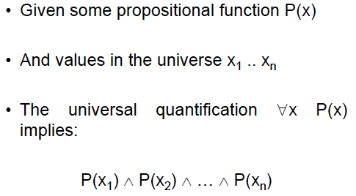
Universal Quantifiers

Slide 10
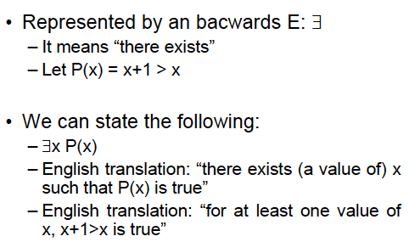
Existential Quantifiers
∃x (x is a student in 22C:19 ⟶ x has traveled abroad)

Slide 11
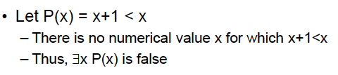
Existential Quantifiers
Note that you still have to specify the domain of x.
Thus, if x is Iowa, then P(x) = x+1 > x is not true.

Slide 12
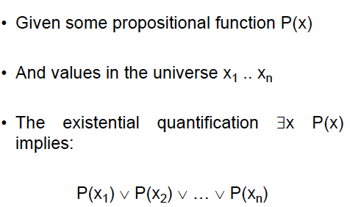
Existential Quantifiers

Slide 13
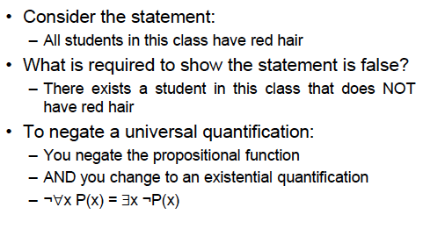
Negating quantification

Slide 14
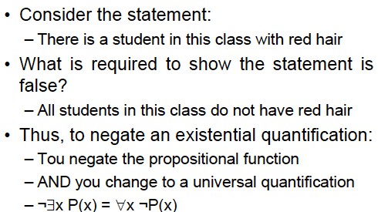
Negating quantification
You

Slide 15

Translating into English
Every student x in this class has studied Calculus.
Let C(x) mean “x has studied Calculus,” and
S(x) mean “x is a student in this class.”

Slide 16
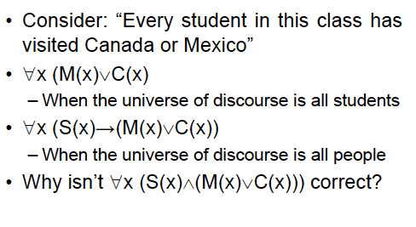
Translating into English

Slide 17
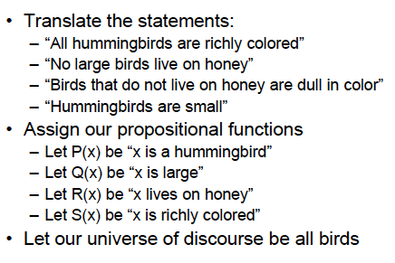
Translating into English

Slide 18
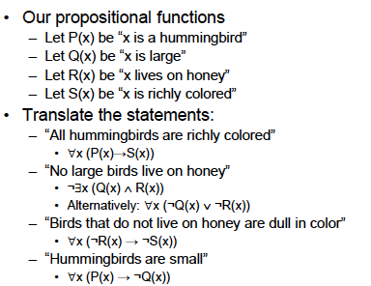
Translating into English

Slide 19
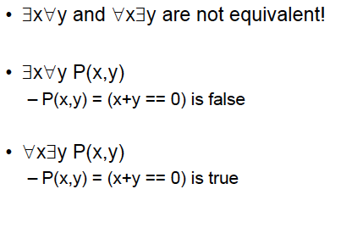
Order of Quantifiers

Slide 20
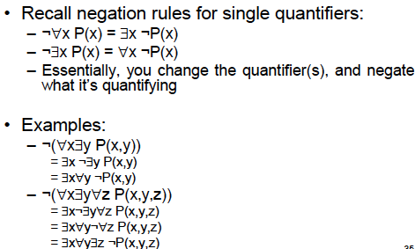
Negating Multiple Quantifiers

Slide 21
More on Quantifiers
∀x ∃y ( x + y = 10 )
∀x ∀y ( x + y = y+ x )
Negation of ∀x P(x) is ∃x (P(x) is false)
(there is at least one x such that P(x) is false)
Negation of ∃x P(x) is ∀x (P(x) is false)
(for all x P(x) is false)

Slide 22
Rules of Inference
p (Let p be true)
p ⟶ q (if p then q)
q (therefore, q is true)
Corresponding tautology [p ⋀ (p⟶ q)] ⟶ q
What is an example of this?

Slide 23
Other Rules of Inference
[(p ⟶ q) ⋀ (q ⟶ r)] ⟶ (p ⟶ r)
[(p ⋁ q) ⋀ ¬ p] ⟶ q
(p ⋀ q) ⟶ p
[(p ⋁ q) ⋀ (¬ p ⋁ r) ⟶ q ⋁ r
(if p is false then q holds, and if p is true then r holds)
Find example of each
Read page 66 of the book

Slide 24
Rules of Inference
¬ q (Let q be false)
p → q (if p then q)
¬ p (therefore, p is false)
Corresponding tautology [¬ q ⋀ (p→ q)] → ¬ p
What is an example of this?

Slide 25
Proofs
To establish that something holds.
Why is it important?
What about proof by example, or proof by simulation, or proof by fame? Are these valid proofs?

Slide 26
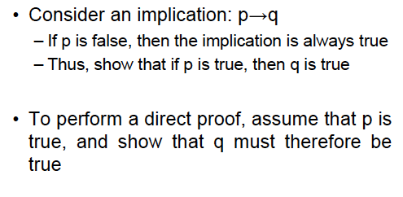
Direct Proofs

Slide 27
Direct Proofs
Example. Prove that if n is odd then n² is odd.
Let n = 2k + 1,
so, n² = 4k² + 4k + 1 = 2 (2k² + 2k) + 1
By definition, this is odd.
Uses the rules of inference

Slide 28
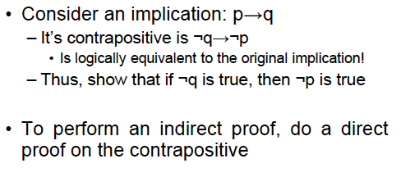
Indirect Proofs

Slide 29
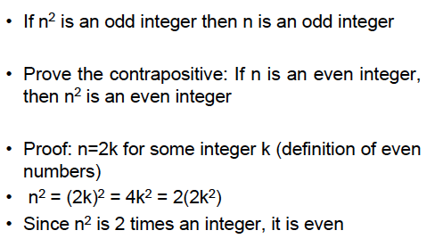
Indirect Proof Example

Slide 30
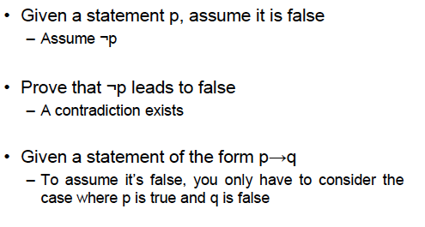
Proof by Contradiction

Slide 31
Proof by contradiction: Example
Assume that the statement of the theorem is false. Then show that something absurd will happen
Example. If 3n+2 is odd then n is odd
Assume that the statement is false. Then n= 2k.
So 3n+2 = 3.2k + 2 = 6k+2 = 2(3k + 1).
But this is even! A contradiction!
This concludes the proof.

Slide 32
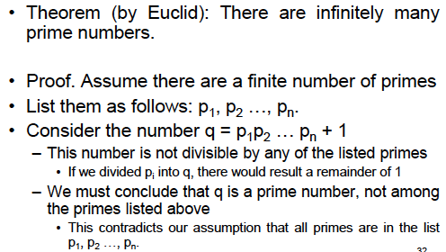
Proof by contradiction: Example

Slide 33
Proof by contradiction: Example
Example. Prove that square root of 2 is irrational.
Assume that the proposition is false.
Then square root of 2 = a/b (and a, b do not have a common factor)
So, 2 = a²/b²
So, a² = 2b². Therefore a² is even. So a = 2c
So 2b² = 4c² . Therefore b² = 2c^{2.} Therefore b² is even. This means b is even.
Therefore a and b have a common factor (2)
But (square root of 2 = a/b) does not imply that.

Slide 34
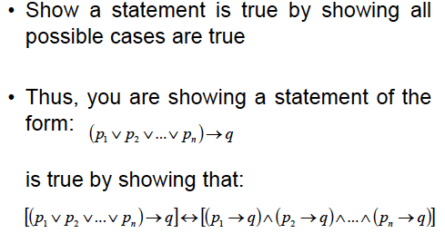
Exhaustive proof

Slide 35
Exhaustive proof
Example. If n is a positive integer, and n ≤ 4, then (n+1) ≤ 3^{n}
Prove this for n=1, n=2, n=3, and n=4, and you are done!
Note. Such a proof is not correct unless every possible case is considered.

Slide 36
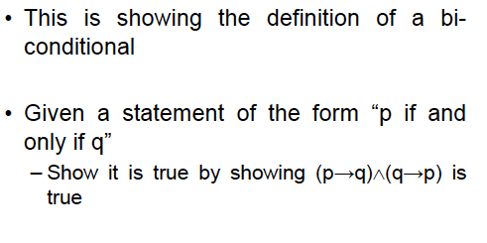
Proof of Equivalence

Slide 37
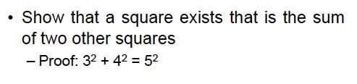
Existence Proofs
Constructive Proof
Non-constructive Proof

Slide 38
Mistakes in proofs
a=b
So, a² = ab
Therefore a² - b² = ab – b²
So, (a+b).(a-b) = b.(a-b)
Therefore a+b = b
So, 2b = b
This implies 2 = 1
What is wrong here?

Slide 39
Counterexample
If you find a single counterexample, then immediately the proposition is wrong.

Slide 40
Difficult problems
Fermat’s last theorem
The equation
x^{n} + y^{n} = z^{n}
does not have an integer solution for x, y, z when
x ≠ 0 , y ≠ 0 , z ≠ 0 and n > 2
(The problem was introduced in 1637 by Pierre de Fermat. It remained unsolved since the 17th century, and was eventually solved around 1990 by Andrew Wiles)

